Slide 1

WILL CRYSTAL PALACE F.C win the 2025/26 UEFA Conference League Final? A predictive analysis project using team performance data
Multi-League analysis
By
Iman Matongo

Slide 2
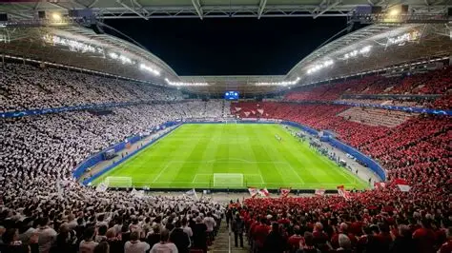
Problem overview
Problem: What is the realistic probability of Crystal Palace to Win the UEFA Conference league final? Accurately prediction is important to helping oliver glasner make the right tactical planning, squad rotation neccessary to maximise palace chance of winning the trophy.
Decision Maker: Steve Parish(Head of football) and Oliver Glasner(Coach)
Why the problem matters: Crystal Palace are in there first ever european final , having won their first 2 trophies last season with the FA cup and the Community Shield, there looking to add another trophy and continue their upwards trajectory.

Slide 3

DATA Description
Limit: Most football data is betting data and often has excessive amount of data that needs to be cleaned or is irrelevant to our analysis.
Data Sources : Webscraping through Excel Power Query from Soccerway, Flashscore and LiveSport for La liga, EPL and UEFA conference league seasons(2024-2025 and 2025-2026)
Datasets Used: 6 CSV files compiled into one dataframe through Python.(EPL) 24-25 and 25-26, LA Liga 24-25 and 25-26 and Uefa Conference League 24-25 and 25-26

Slide 4
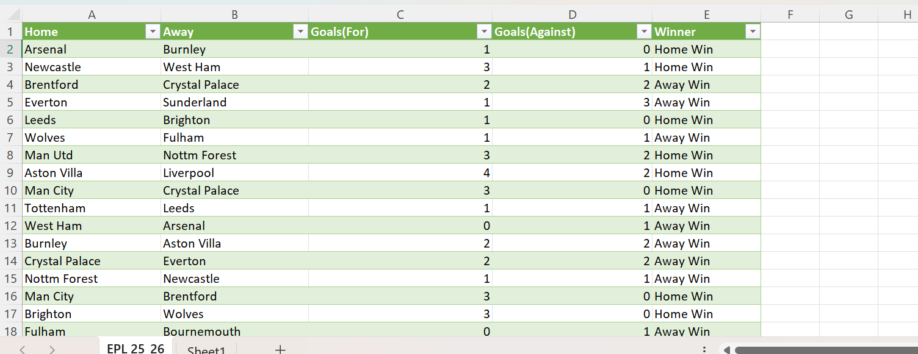
Data Clenaing and Transformation

Slide 5
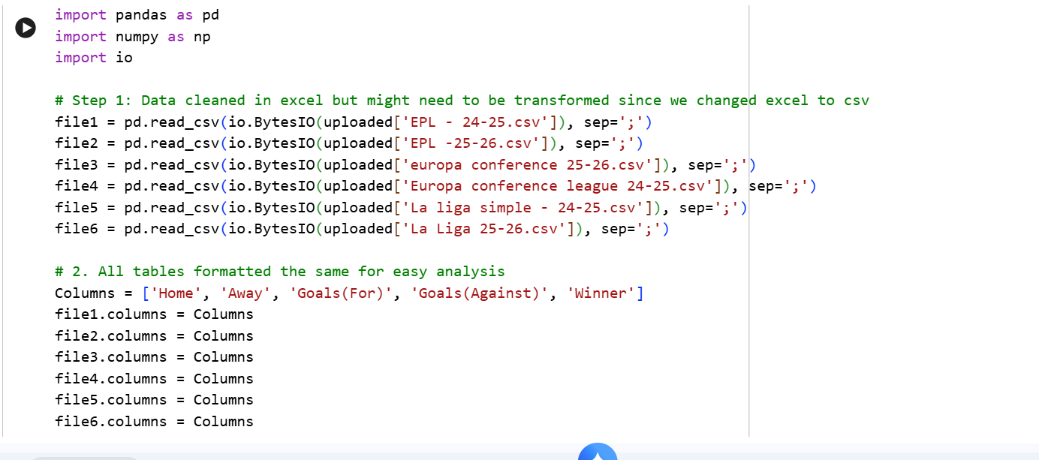
Python:data transformation
Missing values where dropped via .dropna() and string spacing.

Slide 6
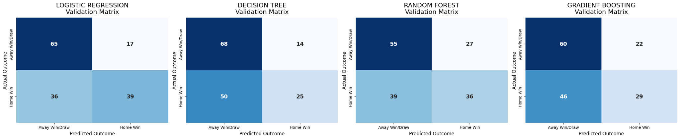
EXPLORATORY DATA ANALYSIS

Slide 7
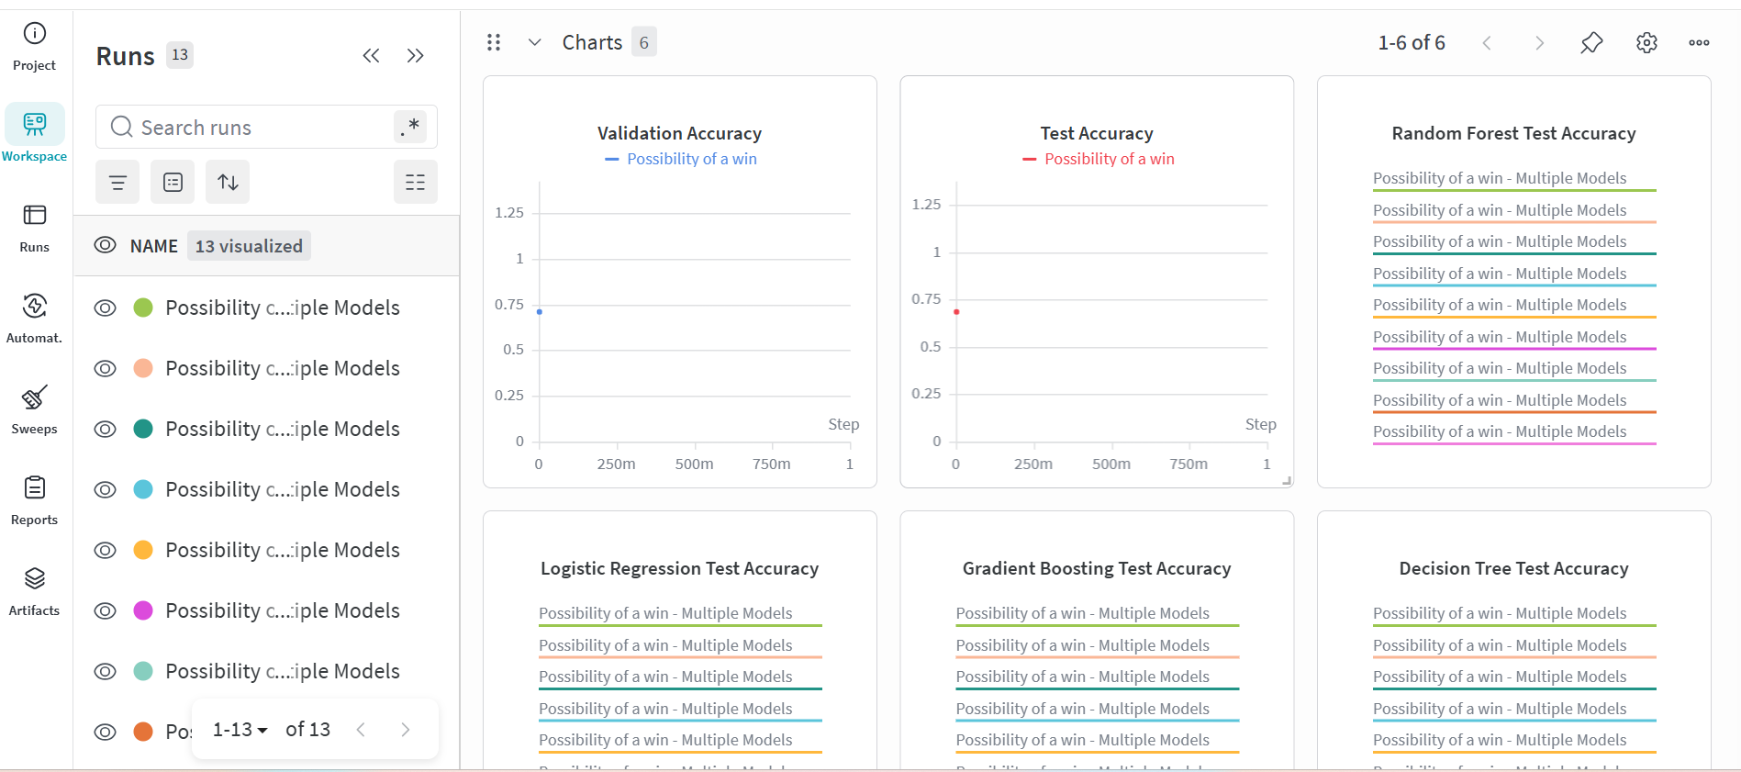

Slide 8
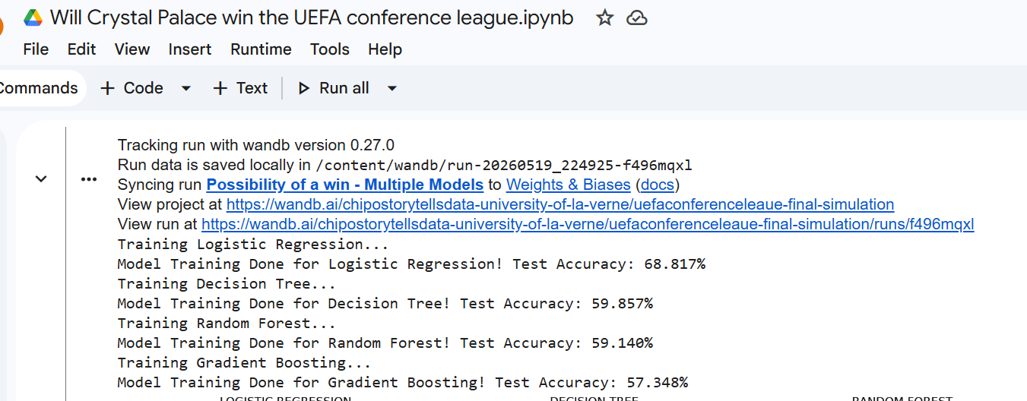
Machine Learning Method

Slide 9
WHY LOGISTIC REGRESSION
The target variables of Home win vs Away win or Draw where better suited to this model as it is more effective for calculating clean probability percentages.
Model Validation: Split the data into 60% training, 15% validation and 25% testing, to ensure that the model actually works.
Results:
Logistic regression accuracy: 68.8%
Decision Tree Accuracy: 59.9%
Random forest accuracy: 59.1%
Gradient Boosting: 57.3%
Logistic regression performed best, and best on the results seems to have avoided all overfitting issues that may have disturbed the tree models.

Slide 10
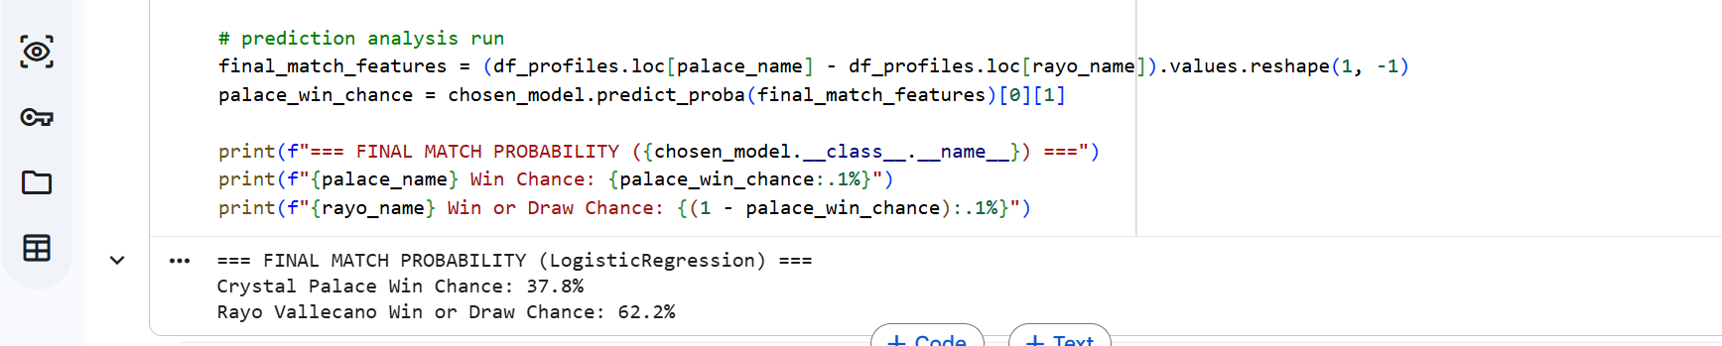
FInal Prediction results

Slide 11

Recommendation
High press, high possession football to try to disrupt Rayo Vallecanos defense
Rest players for the Final and take advantage of the underdog tag in the final.
Since our data is mostly goal data, Palace must implement a better defensive strategy to keep Rayo Vallecano at bay.
Measure of Success:
Win the trophy!
Monitoring expected goal metrics, shot conversion rate and defensive turnovers in the games they have played so far and that Rayo vallecano have played so far.

Slide 12

Limitations (DATA AND MODEL
Data limited to two seasons( would need atleast 5 seasons or more worth of data for a better understanding of the game.
Player and coach stats not included and more metrics.
The data is oversimplified and makes the data seem identical when its not and might mean the model is not so accurate.
SUGGESTIONS
Incorporate Player and coaching data
Incorporate more historical data with both teams performances in high pressure games like finals
Update data as each team plays to get better accuracy.
Use Team strengthens to compare power index, squad value etc.
Possible try using different simulation models like maybe monte carlo to see what the prediction will be each time.

